Slide 1
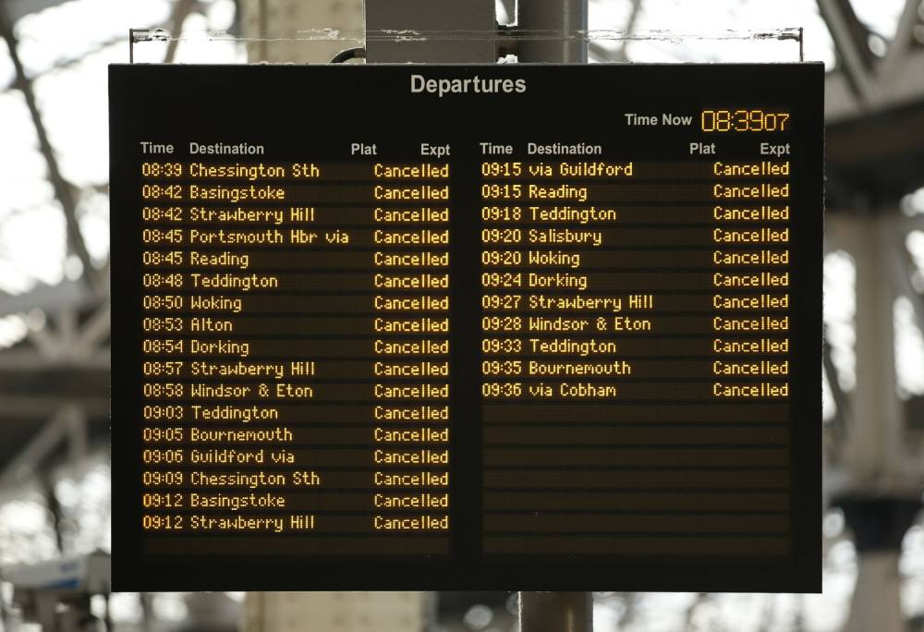
Disruption Feed

Slide 2
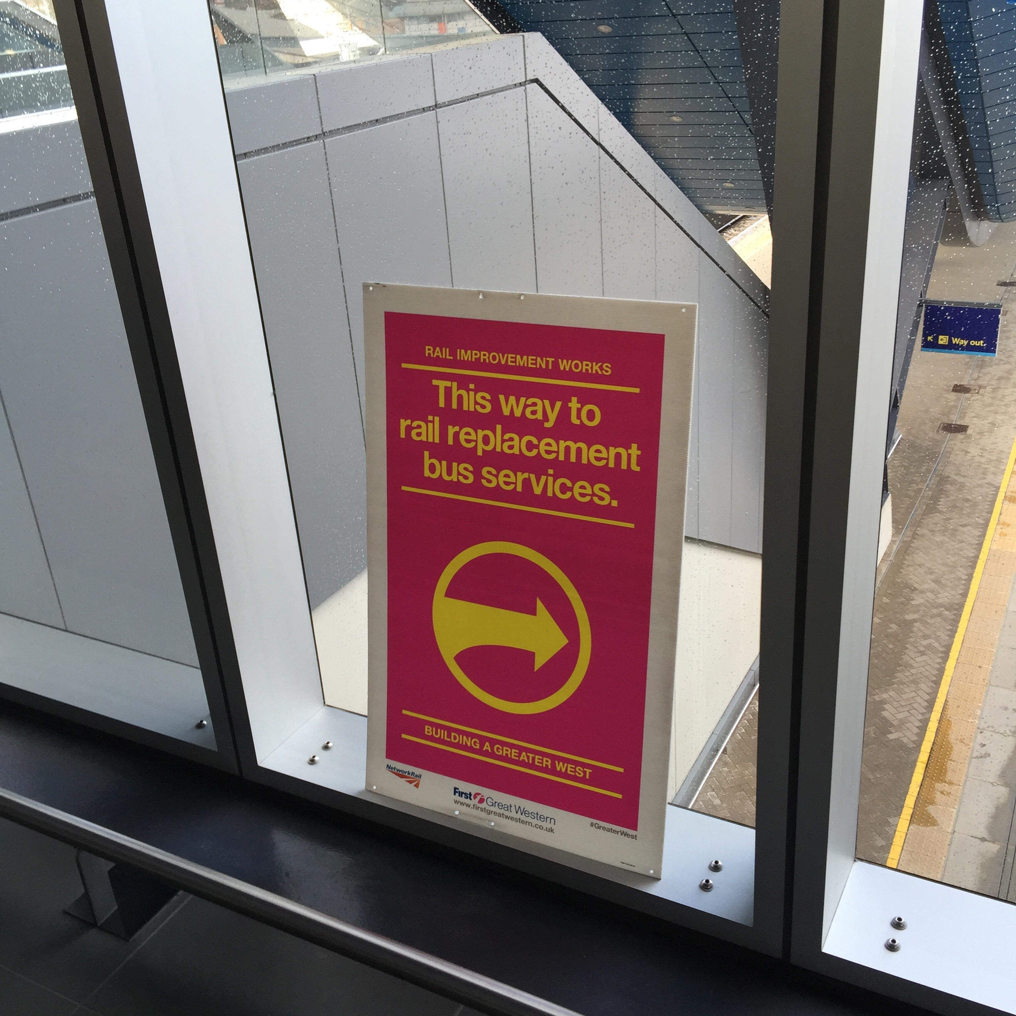
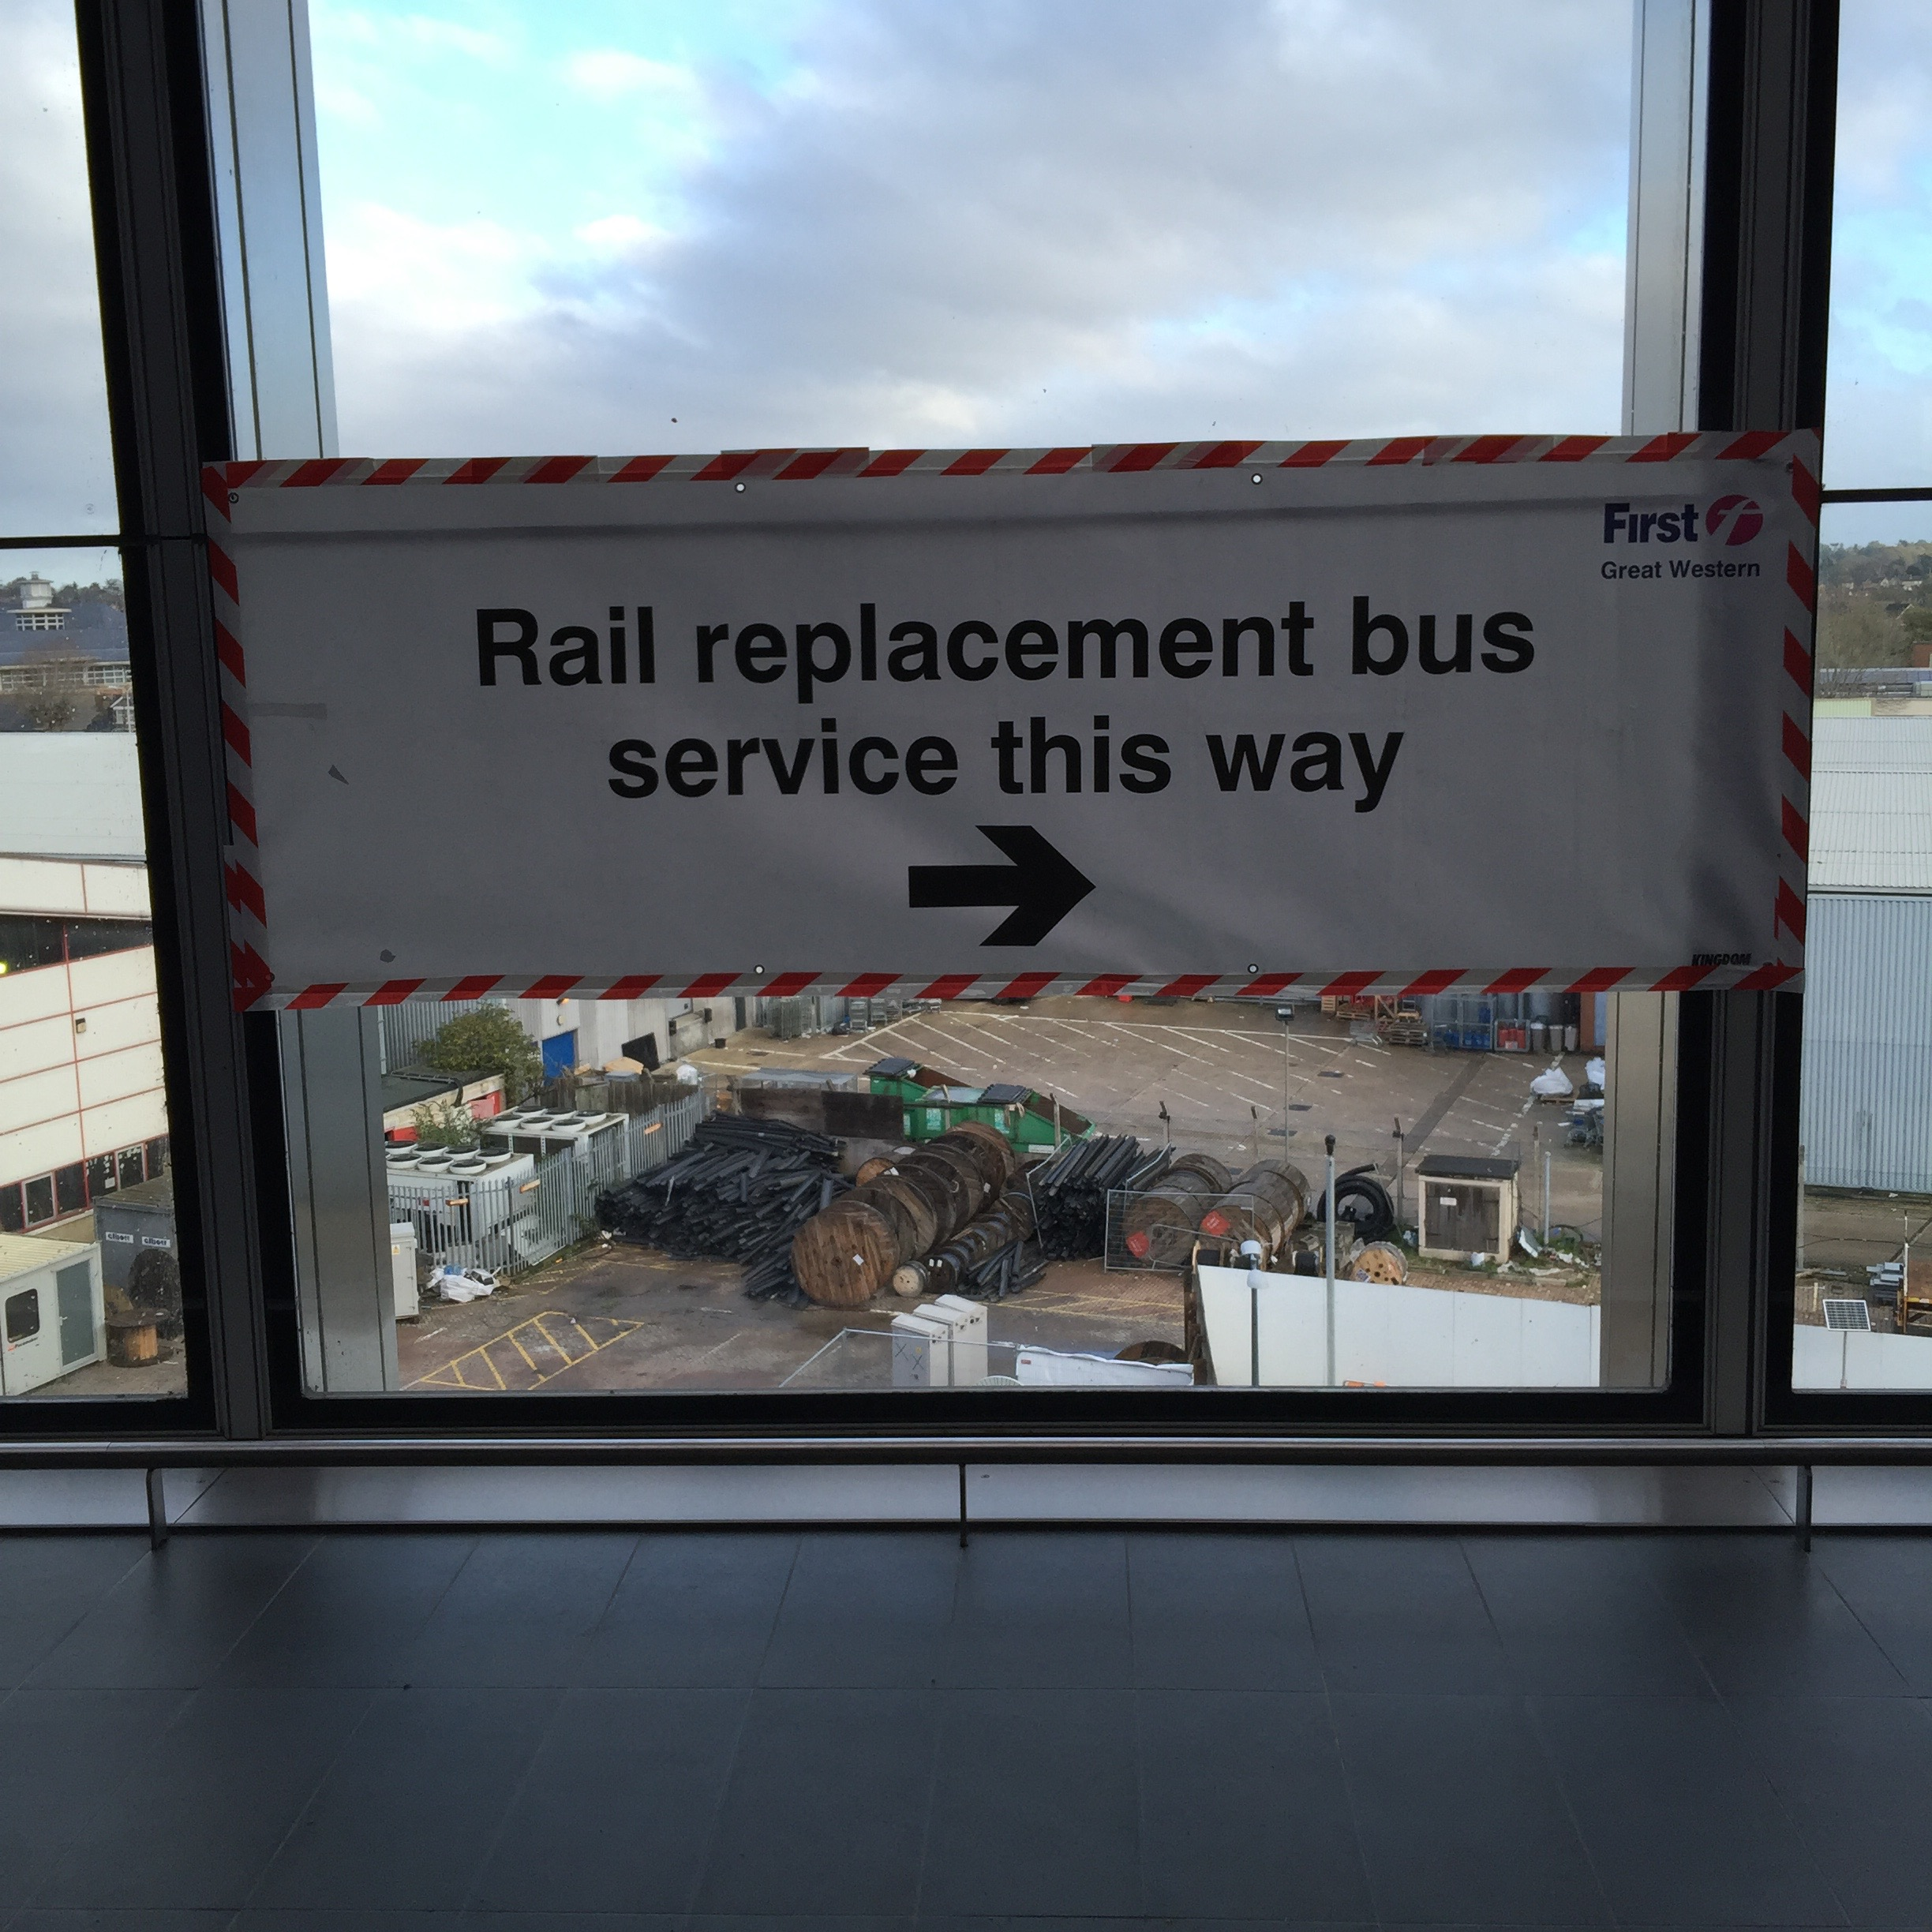
Planned disruptions at station

Slide 3
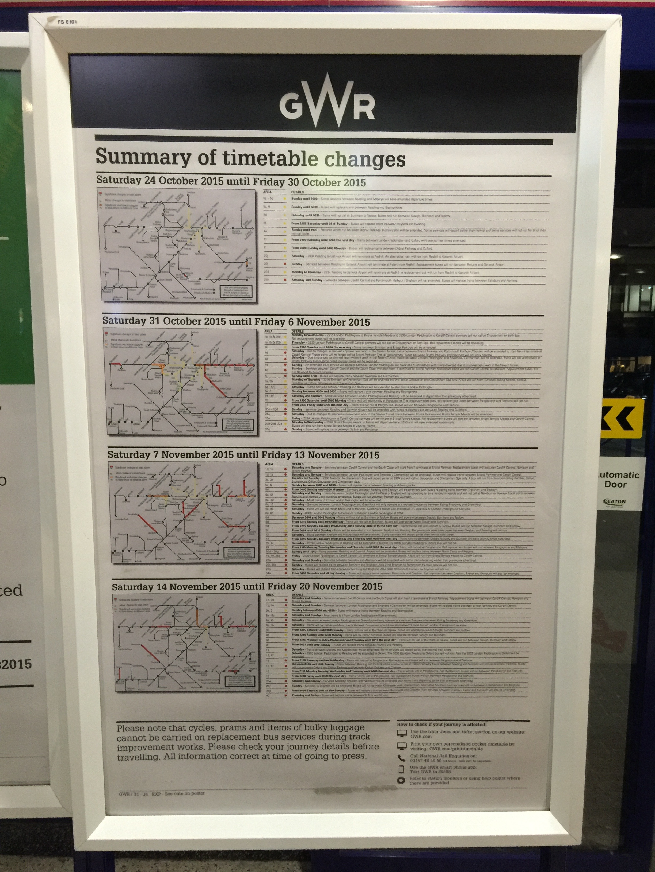
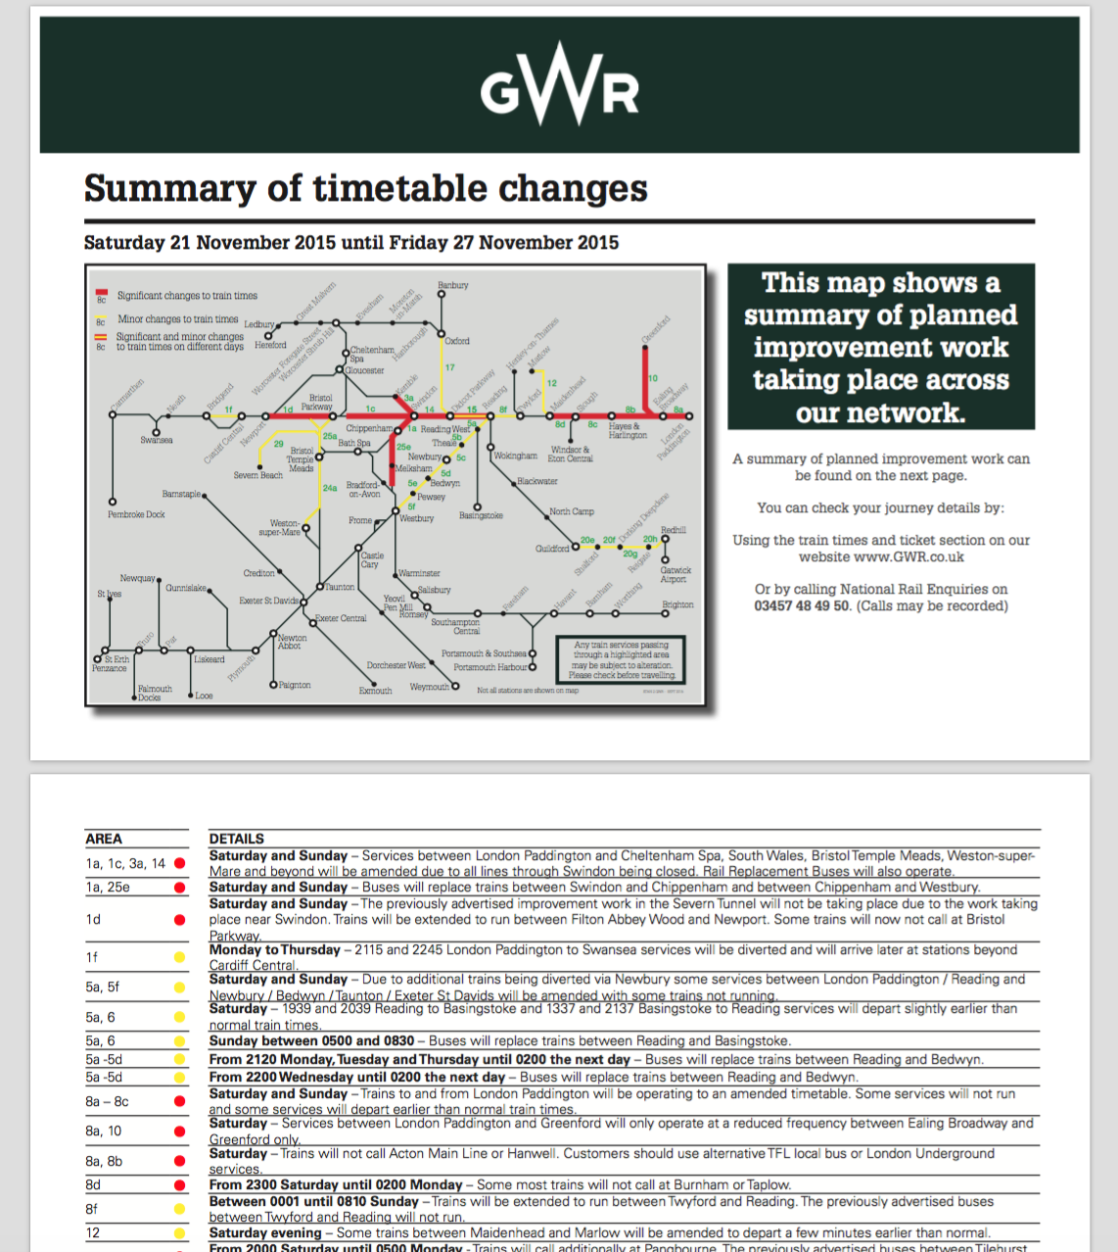
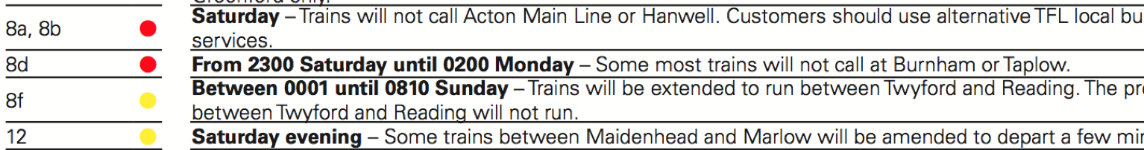
Planned disruption posters at station

Slide 4
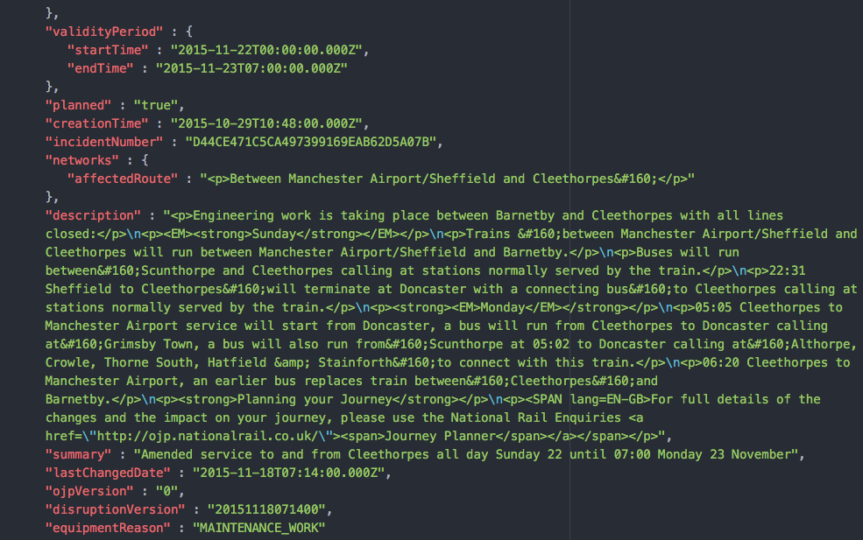
Current data structure in Darwin

Slide 5
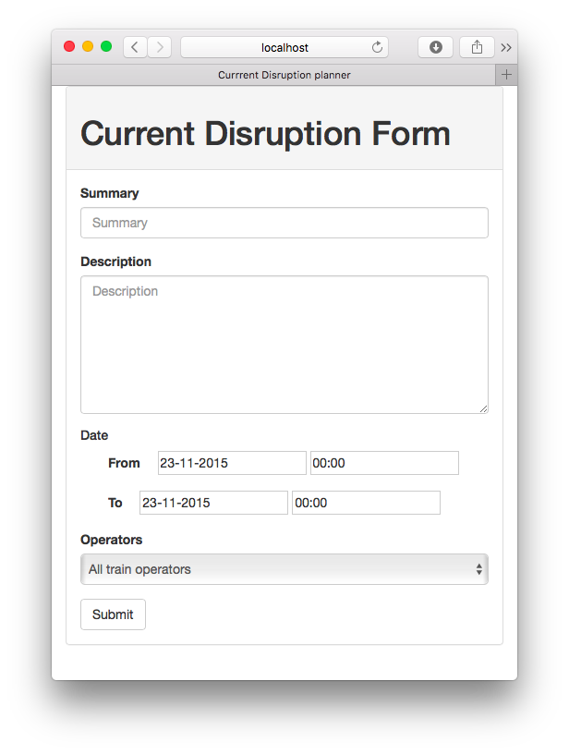
Current data input form

Slide 6
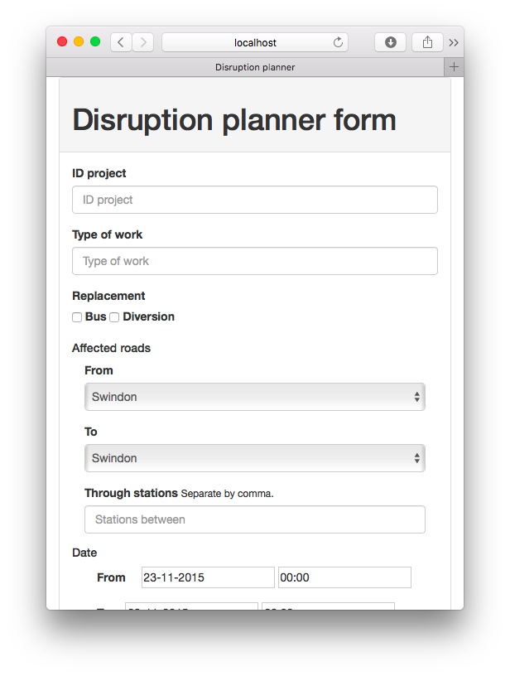
Purposed new data input form

Slide 7
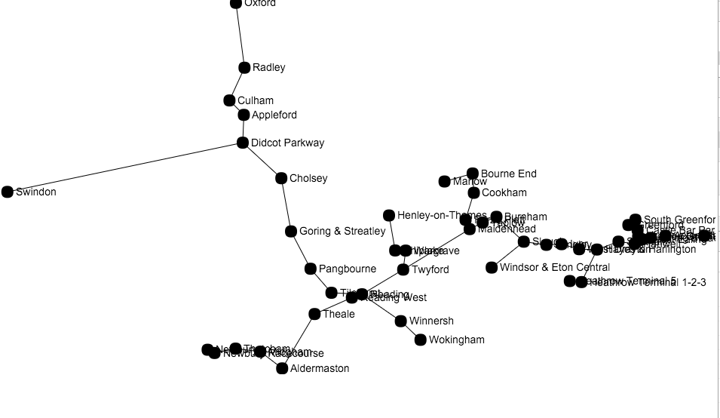
Plan disruption visualisation

Slide 8
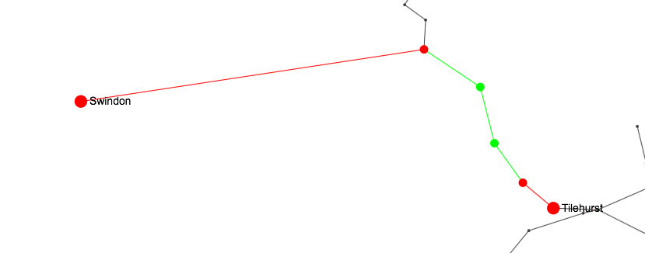
Planned disruption visualisation

Slide 9
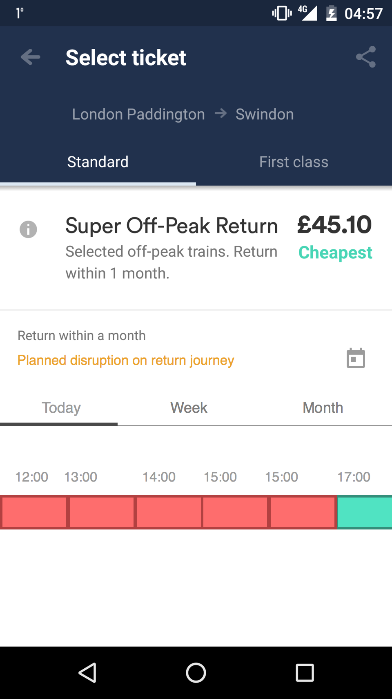
Integrations

Slide 10
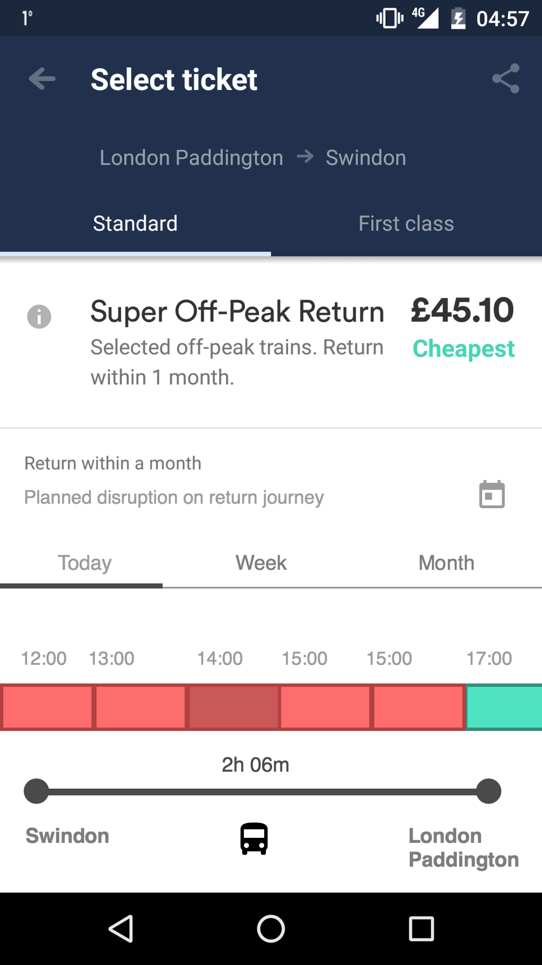
Integrations

Slide 11
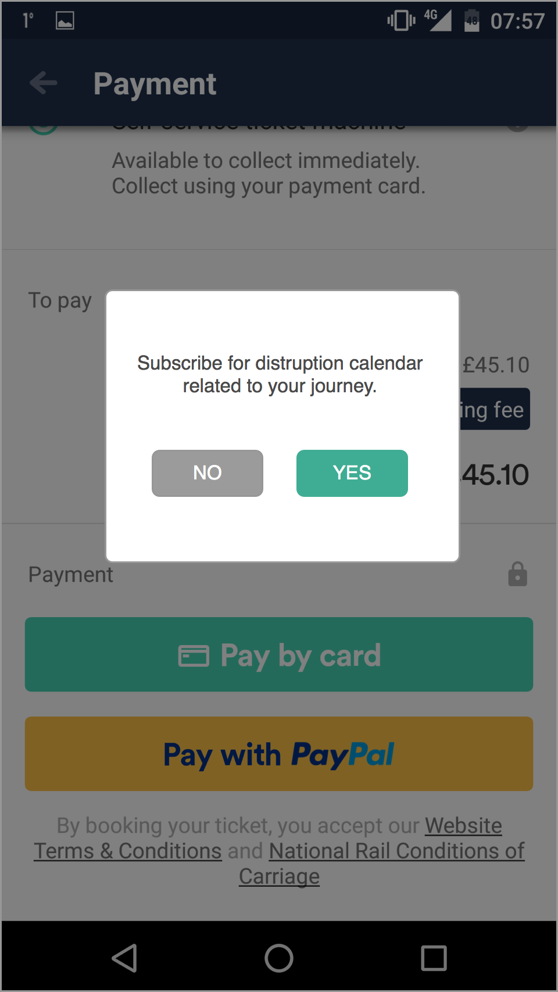
Integrations

Slide 12




Market

Slide 13
Business Model
Annual subscription to the service
Structured data collection capability
Interactive map for data visualisation
API for data integration to ticket booking service

Slide 14
Next Steps
Gather all planned disruption data in a structured way
Capability to download disruption plan to smart phone calendar
Work with rail operators to integrate the service on the booking platforms

